Slide 1

MEDICAL-CARD
SHRI VAISHNAV INSTITUTE OF TECHNOLOGY AND SCIENCE, INDORE
DEPARTMENT OF INFORMATION TECHNOLOGY
PRESENTED BY-
Pratibha Baghare (0802IT131071)
Priyanka Chouhan(0802IT131073)
Tiju Cherian (0802IT131108)
Vinay Mishra (0802IT131113)
GUIDED BY-
Mr. Gourav Vinchurkar
Mr. Jitendra Sharma

Slide 2

CONTENT
Introduction
Problem Domain
Solution Domain
System Domain
Application Domain
Expected Outcome
UML Diagrams
Website Demonstration
References

Slide 3
INTRODUCTION
Medical Card is a web based platform from where users can safely store and easily access their medical records for their reference whenever and wherever it is needed. It will help not only the patients but also the doctors who will be able to keep track of their patients records in an effective way and also monitor the health of their patients track the effects of the medicines on patients health whether they are working well or not. The patients will also be benefited because they will be able be know about doctor’s specializations and skill sets which will help them to decide which doctors to consult for the solution of a specific problem.

Slide 4
PROBLEM DOMAIN
Maintaining complete medical records and entire patient history is very hectic job as medical documents and records can get lost or misplaced over a long duration of time for a patient .
They cannot be searched quickly when a decision must be made by the care provider at the point of care.
Someone has to manage all the Records and the physical space they occupy.

Slide 5
PROBLEM DOMAIN (conti....)
A competent filing person must be employed who can put the Records in the proper place so they can be retrieved again.
Any backup copy of the Records must be made by hand or by automatic copier (with the associated expenses of a copy machine), and physically transported to a safe archival location.
Paper Records are susceptible to unplanned destruction, whether by rodents, flooding, fire, etc.

Slide 6
SOLUTION DOMAIN
Enabling quick access to patient records for more coordinated, efficient care using Relational Database.
Securely sharing electronic information with patients and other clinicians. Helping providers more effectively diagnose patients, reduce medical errors, and provide safer care using HTTPS.
Enhancing privacy and security of patient data by using SHA-1 & SHA-2.
Using digital tools to electronically book appointments, view lab test results, consult with care providers or request prescription renewals makes care more convenient and efficient, and saves time for patients and providers using a Graphical User Interface(GUI).
Digital diagnostic imaging systems have cut time needed to evaluate scans by 30-40 per cent, allowing patients to get diagnosed faster and start treatment sooner.

Slide 7
SOLUTION DOMAIN (conti....)
Electronic health records allow doctors to see a patient’s complete health information, saving time, reducing duplicate tests, and leading to better patient care decisions.
Electronic medical records allow doctors to manage patient problems, such as chronic disease, more effectively, as well as improving office efficiency.

Slide 8
Online care allows patients and clinicians to collaborate in monitoring health conditions, reducing the need for emergency visits and hospitalization.
Drug information systems reduce prescription errors and abuse, alert pharmacists to potentially harmful drug interactions, and help patients take their medications as prescribed.
Electronic health records allow doctors to see a patient’s complete health information, saving time, reducing duplicate tests, and leading to better patient care decisions.
Electronic medical records allow doctors to manage patient problems, such as chronic disease, more effectively, as well as improving office efficiency.

Slide 9









SYSTEM DOMAIN
S/W Requirement
Java 1.7, Servlet 2.x, Jsp, JDBC, AngularJS 1.x
MySQL 5.x, Hibernate 3.x, Spring 3.x
Apache Tomcat 9.0 Server
Git, Maven, 2.x, Log4j, Eclipse Neon
API's like Gmail, OpenCV, Tessaract etc
H/W Requirement
Pantium based System
2gb RAM
100gb HDD

Slide 10
APPLICATION DOMAIN
Our project will radically transform the entire current medical record management system in India. The health sector will benefit a lot from the project because the people will be able to store their records in an effective way from where they can be accessed very easily. It will benefit the doctors, nurses, patients, physicians and the government too. The major change will be in the life of people when they would no longer have the need to carry the paper documents, reports and prescriptions. Everything would be stored online from where they could be accessed securely and effectively. Keeping track of records and health improvement or deterioration would a whole lot easier thus ultimately benefiting the people who usually do not get the expected level of medical treatment even at high costs. It would integrate the hospitals, labs, clinics etc. and store the records in a repository making the whole process of treatment a lot more effective.

Slide 11
EXPECTED OUTCOME
A web application which will allow its users to do following things:
The users will be able to store their medical records online in a safe and secure way such that they would be easily able to access it whenever and wherever needed.
The doctors and other medical staff would be easily able to keep track of their patient’s health condition and previous reports, medications, referred physicians etc.
The patients would be easily able to find suitable doctors based on their specializations and skill sets.
Their would no longer be the need to carry any paper documents and reports, therefore no risk of misplacement or loss of valuable medical records as they all will be available online which could be readily accessed by the user.
The government agencies too would be easily able to keep track of the medical state of people and diseases prevalent in the country and suitable policies accordingly.

Slide 12
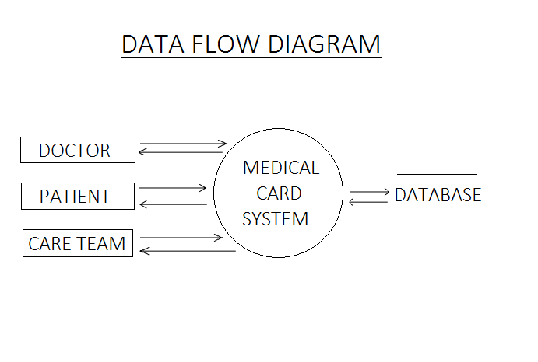

Slide 13
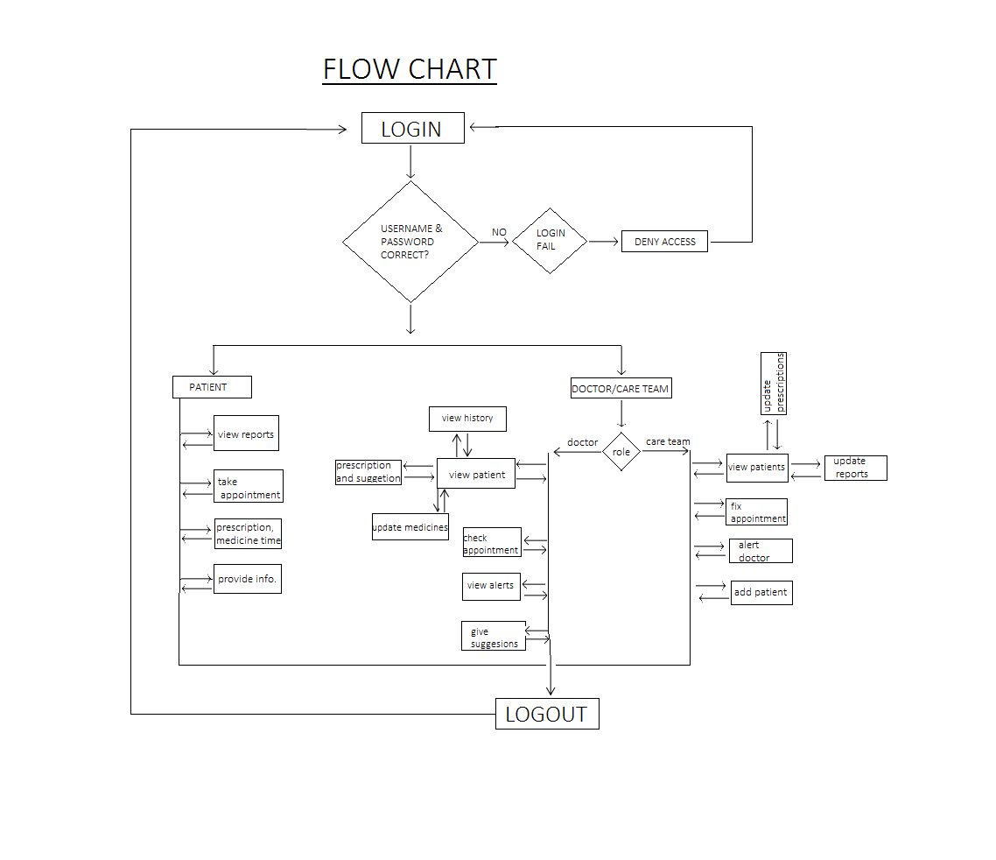

Slide 14
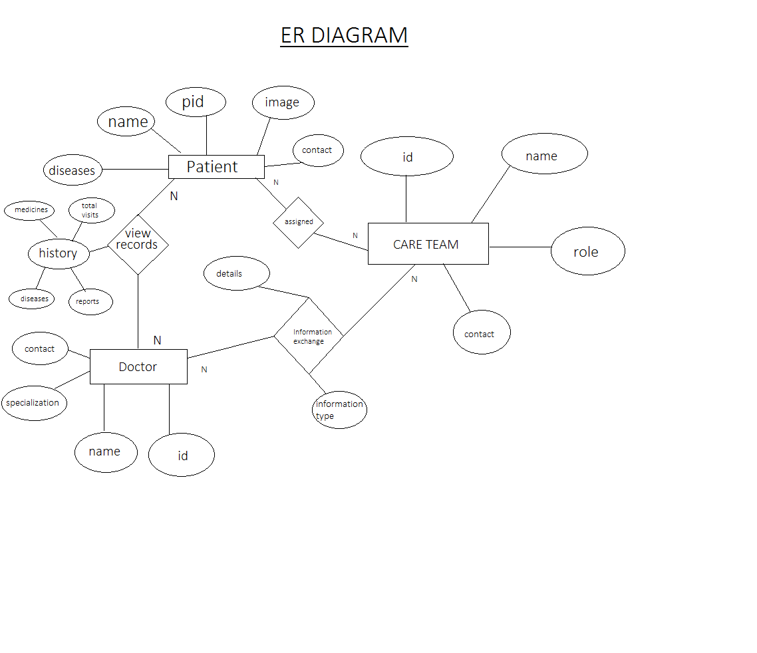

Slide 15
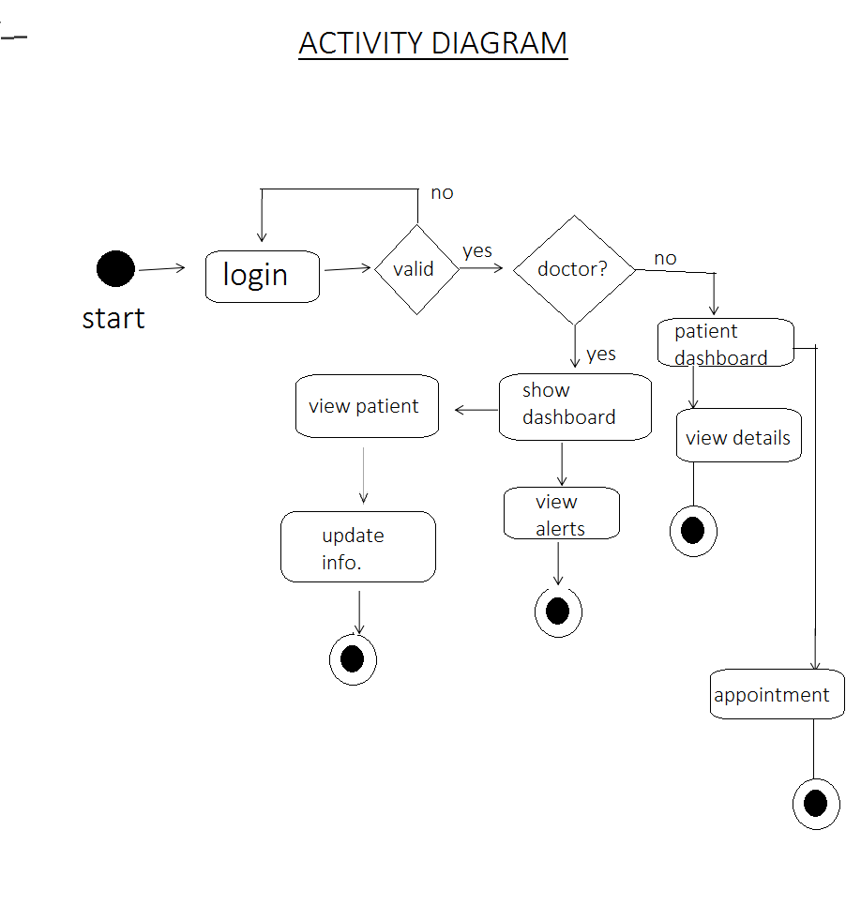

Slide 16
LOGIN PAGE

Slide 17
DASH BOARD

Slide 18
ADD PATIENT

Slide 19
VIEW PATIENT

Slide 20
ADMIN TABLE

Slide 21
PATIENT TABLE

Slide 22


Slide 23


Slide 24
REFERENCES
Google Search
Mr. Dinesh Patel ( IT dept)
Mr. Gaurav Vinchurkar ( IT dept)

